Slide 1
Introduction to Big Data Systems
Lecture 7. Graph Computing I
Wenguang CHEN
Tsinghua University

Slide 2
Outline
Applications of Graph Analysis
Vertex-centric graph processing
Asynchronous processing
Graph partition on power law graphs and GAS model
Out of core graph processing

Slide 3
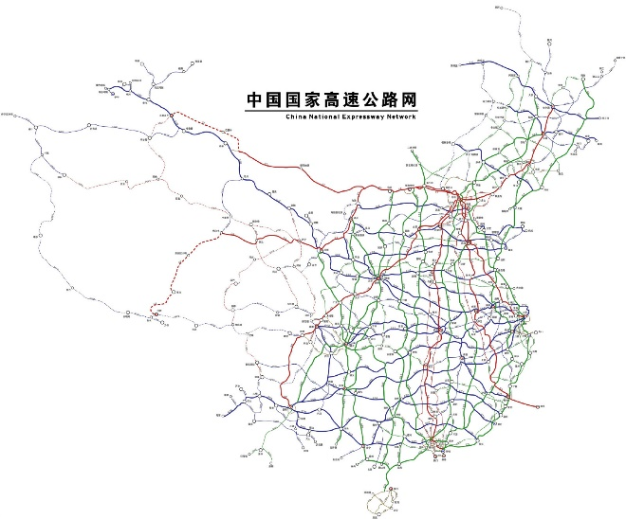
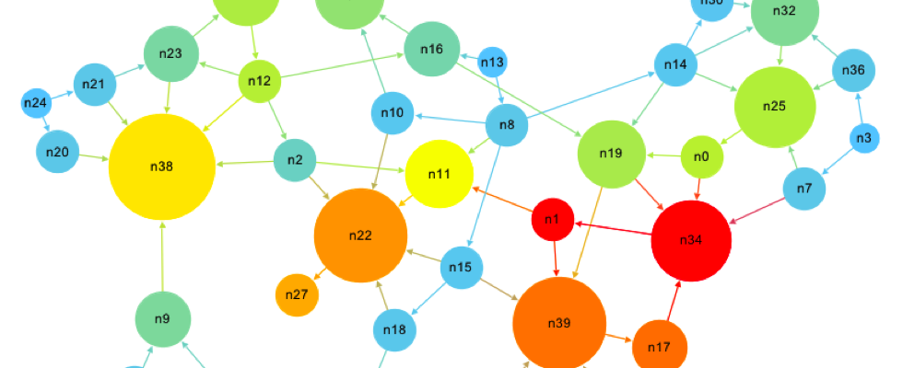
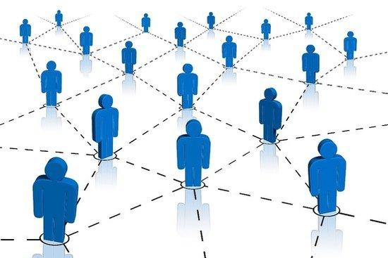
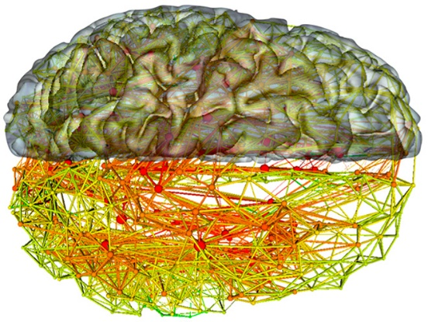
Graph is a Fundamental Data Structure
Road graph
Apps: Navigation, traffic management
Size: 100 million edges
Web graph
Apps: Webpage ranking, spam-page detection
Size: 10 trillion edges
Social network graph
Apps: Community discovery, public opinion analytics
Size: 100 billion edges
Brain graph
Apps: Translational neuroscience
Size: 100 trillion edges
Notes:
We see graphs everywhere and people use graph computing more and more nowadays. In particular, advances in technology allows us to process larger graphs.
The first example is Road Graph, in which roads, as edges, connect cities, as vertices. Computing on road graphs performs familiar tasks such as navigation, traffic management, and city planning.
We are all familiar with another type of graph, the social network graph, on which we can perform tasks like community discovery and public opinion analysis.
Web graph is another important type graph, which we rely on everyday when using search engines.
The last example is brain graph, with neurons as vertices and synapsis as edges, whose processing enables tasks like translational neuroscience.
A common problem we face is that, the graphs are growing larger. E.g., the graphs mentioned above have hundreds of million to hundreds of trillion edges. Such problem scale ex'ceeds the capability of typical servers or clusters, and naturally, one thinks of supercomputers!

Slide 4
Analysis on Graphs
Local query
Global Analysis
Complex
Path
Importance
Pattern
Dependence
Community
Graph NN

Slide 5
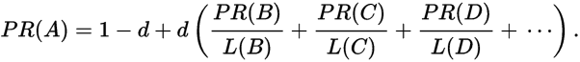
Algorithms on Global Graph Analysis
B
38.4
C
34.3
PR (PageRank)
BFS (Breadth First Search)
WCC (Weakly Connected Component)
BC (Betweenness Centrality)
…
A
3.3
D
3.9
E
8.1
F
3.9
1.6
1.6
1.6
1.6
1.6
*Figure from J. Leskovec

Slide 6
Applications of Graph Analytics
Real-time Recommendation
Click-farming detection
Fraud detection
*Images from Zhengping Qian, Alibaba

Slide 7
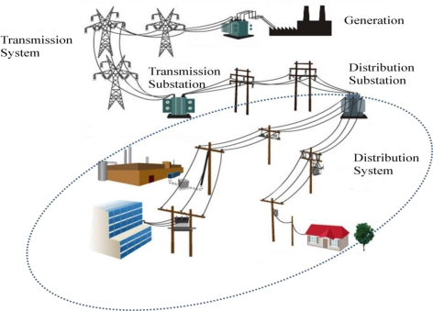
Applications of Graph Analytics
Power Grid Simulation
Program Analysis
IoT Management

Slide 8
Find the people
Ph. No..
id
1
Dev
ID
Addr
id
k
Dev
ID
Ph. No.

Slide 9
Graph Model for fraud detection
Model the applications/addresses/ phone numbers as the vertices
Use community detection algorithms to find fraud group
applications
Addresses
Telephone number

Slide 10
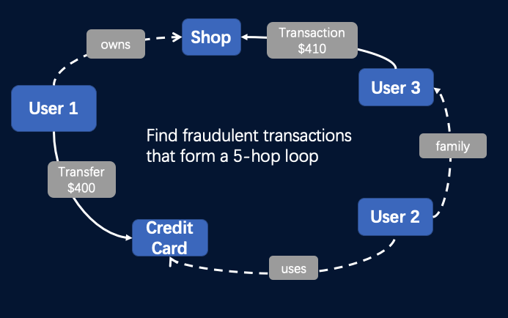
A real example of graph-base risk control in industry
Cycle detection on transaction graph

Slide 11
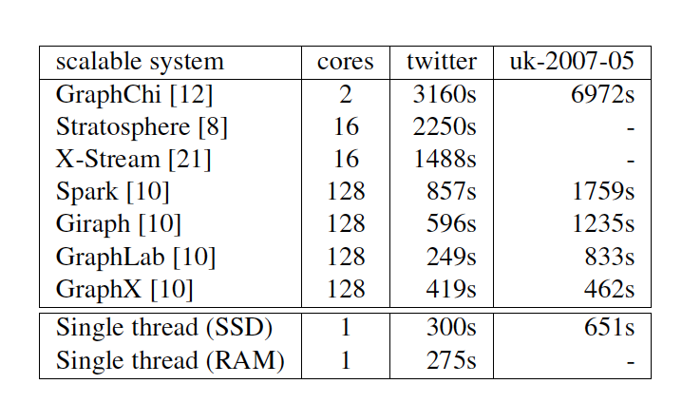
Extreme-Scale Graph Processing with Spark?
Can we use Spark(GraphX) to process large graph?
Unfortunately no, because it is slow* and
memory inefficient**
*McSherry, Frank, Michael Isard, and Derek Gordon Murray. "Scalability! but at what COST?." HotOS. 2015.
**Zhu, Xiaowei, et al. "Gemini: A Computation-Centric Distributed Graph Processing System." OSDI. 2016.
Require more efficient graph processing systems

Slide 12
Outline
Applications of Graph Analysis
Vertex-centric graph processing
Asynchronous processing
Graph partition on power law graphs and GAS model
Out of core graph processing

Slide 13
Graph Processing Systems
Out of core
Shentu
SC’18
In
Mem
Single
Machine
Multiple
Machine

Slide 14
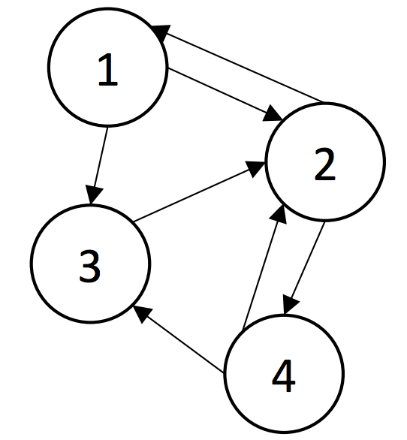
A graph example
Vertex:
1,2,3, 4
Edges:
(1,2) (1,3)
(2,1) (2,4)
(4,2) (4,3)
For Vertex 1:
In edge: (2,1)
Out edge: (1,2) (1,3)

Slide 15

Think like a vertex
PageRank (one iteration):
Foreach v in activeVertices:
Foreach u in v.outNeighbors
Generate msg(R[v] * w_{vu})
Send msgs to destination vertices
Receive msgs from source vertices
Initialize S[u] = 0
Foreach msg in msgs:
Update msg to destination vertex u
(S[u] = S[u] + msg)
R[u] = 0.15 * R[u] + 0.85 * S[u]
Notes:
First, some background on the graph processing model that we choose, using pagerank as an example.
Many graph computation tasks are iterative, running until the state converges or after a certain number of iterations. First, each active vertex produces message based on its outgoing edges. Then each vertex sends and receives messages along its edges, and finally updates its state, in this case the pagerank value.

Slide 16
Bulk Synchronous Parallel Model: Pregel (Giraph)
[Valiant ‘90]
Compute
Communicate
Barrier

Slide 17
MPI vs Pregel vs Spark
Data model
Mutable / immutable
Fault tolerance
Checkpoint/recompute
Elastic Scheduling
Performance

Slide 18
BSP Systems Problem: Curse of the Slow Job
Iterations
Data
Data
Data
Data
CPU 1
CPU 1
CPU 1
Data
Data
Data
Data
Data
Data
Data
Data
CPU 2
CPU 2
CPU 2
Data
Data
Data
Data
Data
Data
Data
Data
CPU 3
CPU 3
CPU 3
Data
Data
Data
Data
Data
Data
Data
Data
Barrier
Barrier
Barrier

Slide 19
Weakly Connected Components
Algorithm
Give each vertex an Look at all edges and find the vertex id who holds the highest value.
Send the greatest vertex id to all the edges.
Process incoming messages and compare it against the value you hold.
Repeat the process until there are no messages being sent.
What happens if this algorithm is executed asynchronously?

Slide 20
Outline
Applications of Graph Analysis
Vertex-centric graph processing
Asynchronous processing
Graph partition on power law graphs and GAS model
Out of core graph processing

Slide 21
The BSP model does not support asynchronous computing
Compute
Communicate
Barrier

Slide 22
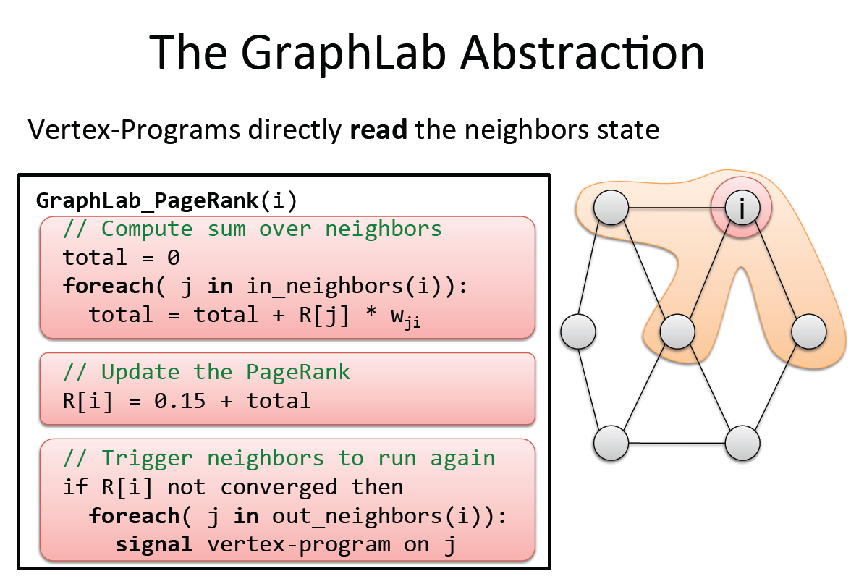

Slide 23
Data Graph
Data associated with vertices and edges
Graph:
Social Network
Vertex Data:
User profile text
Current interests estimates
Edge Data:
Similarity weights

Slide 24
Update Functions
User-defined program: applied to vertex transforms data in scope of vertex
pagerank(i, scope){
// Get Neighborhood data
(R[i], w_{ij}, R[j]) ←scope;
// Update the vertex data
// Reschedule Neighbors if needed
if R[i] changes then
reschedule_neighbors_of(i);
}
Update function applied (asynchronously)
in parallel until convergence
Dynamic computation

Slide 25
Ensuring Race-Free Code
How much can computation overlap?

Slide 26
An execution plan example

Slide 27
Need for Consistency?
No Consistency
Higher Throughput
(#updates/sec)
Potentially Slower Convergence of ML

Slide 28
Consistency in Collaborative Filtering
Inconsistent updates
Consistent updates
GraphLab guarantees consistent updates
User-tunable consistency levels
trades off parallelism & consistency
Netflix data, 8 cores
Notes:
Full netflix, 8 cores
Highly connected movies, bad intermediate results

Slide 29
Outline
Applications of Graph Analysis
Vertex-centric graph processing
Asynchronous processing
Graph partition on power law graphs and GAS model
Out of core graph processing

Slide 30
The need for partition graphs
Road graph
Apps: Navigation, traffic management
Size: 100 million edges
Web graph
Apps: Webpage ranking, spam-page detection
Size: 10 trillion edges
Social network graph
Apps: Community discovery, public opinion analytics
Size: 100 billion edges
Brain graph
Apps: Translational neuroscience
Size: 100 trillion edges

Slide 31
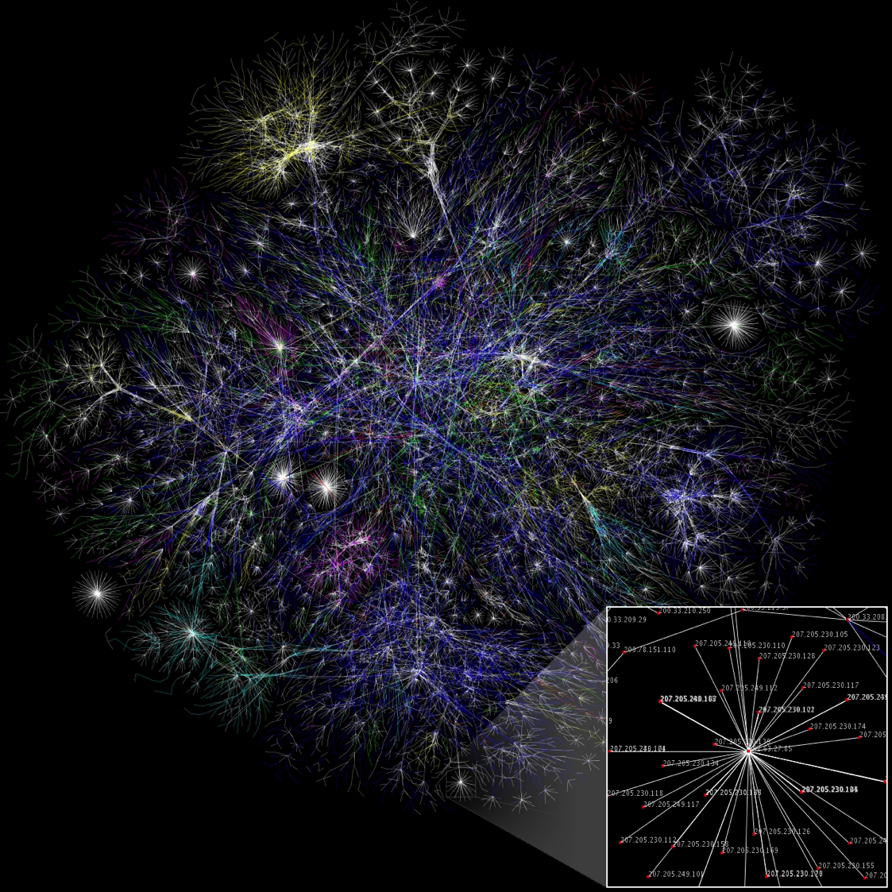
Natural Graphs
[Image from WikiCommons]

Slide 32
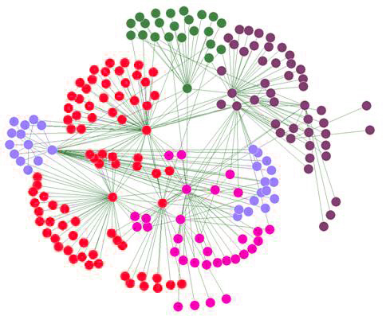
Assumptions of Graph-Parallel Abstractions
Idealized Structure
Natural Graph
Small neighborhoods
Low degree vertices
Vertices have similar degree
Easy to partition
Large Neighborhoods
High degree vertices
Power-Law degree distribution
Difficult to partition

Slide 33
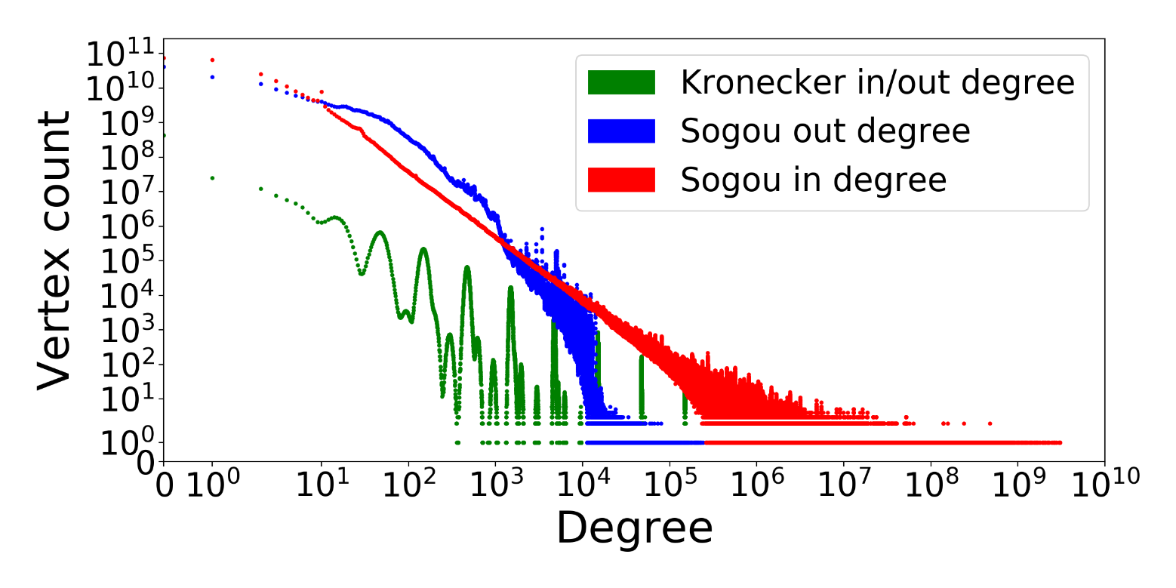
Natural Graphs → Power Law
Chinese web graph from Sogou search engine
273 billion webpages (vertices)
12 trillion links (edges)
137 TB on-disk storage (compressed)
Power-law degree distribution
Asymmetric in/out degree distribution
Real-world graph has higher skew
MAX: 381 thousand
AVG: 45
MAX: 47.6 million
AVG: 16

Slide 34
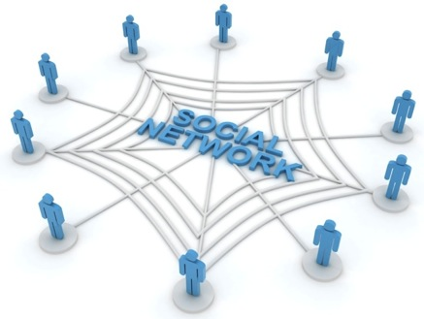


High Degree Vertices are Common
“Social” People
Popular Movies
Users
Netflix
Movies
Hyper Parameters
Common Words
θ
B
α
θ
Docs
LDA
Z
θ
Z
θ
Z
Z
Z
Z
Z
Obama
Z
w
Z
w
Z
Z
w
Z
w
Z
w
Z
w
w
Z
w
Z
w
w
w
Words
w
w
w
w
w

Slide 35
Problem: High Degree Vertices Limit Parallelism
Edge information too large for single machine
Touches a large
fraction of graph
(GraphLab 1)
Produces many
messages
(Pregel)
Sequential
Vertex-Updates
Asynchronous consistency requires heavy locking (GraphLab 1)
Synchronous consistency is prone to stragglers (Pregel)

Slide 36
Problem: High Degree Vertices ➔ High Communication for Distributed Updates
Data transmitted
across network
O(# cut edges)
Y
Natural graphs do not have low-cost balanced cuts
[Leskovec et al. 08, Lang 04]
Popular partitioning tools (Metis, Chaco,…) perform poorly
[Abou-Rjeili et al. 06]
Extremely slow and require substantial memory
Machine 1
Machine 2

Slide 37
Random Partitioning
Both GraphLab 1 and Pregel proposed Random (hashed) partitioning for Natural Graphs
For p Machines:
10 Machines → 90% of edges cut
100 Machines → 99% of edges cut!
Machine 1
Machine 2

Slide 38
In Summary
GraphLab 1 and Pregel are not well suited for natural graphs
Poor performance on high-degree vertices
Low Quality Partitioning

Slide 39
2
Distribute a single vertex-update
Move computation to data
Parallelize high-degree vertices
Vertex Partitioning
Simple online approach, effectively partitions large power-law graphs

Slide 40
Minimizing Communication in GraphLab 2: Vertex Cuts
Communication linear in # spanned machines
Y
Y
Y
A vertex-cut minimizes # machines per vertex
Percolation theory suggests Power Law graphs can be split by removing only a small set of vertices [Albert et al. 2000]
➔
Small vertex cuts possible!

Slide 41
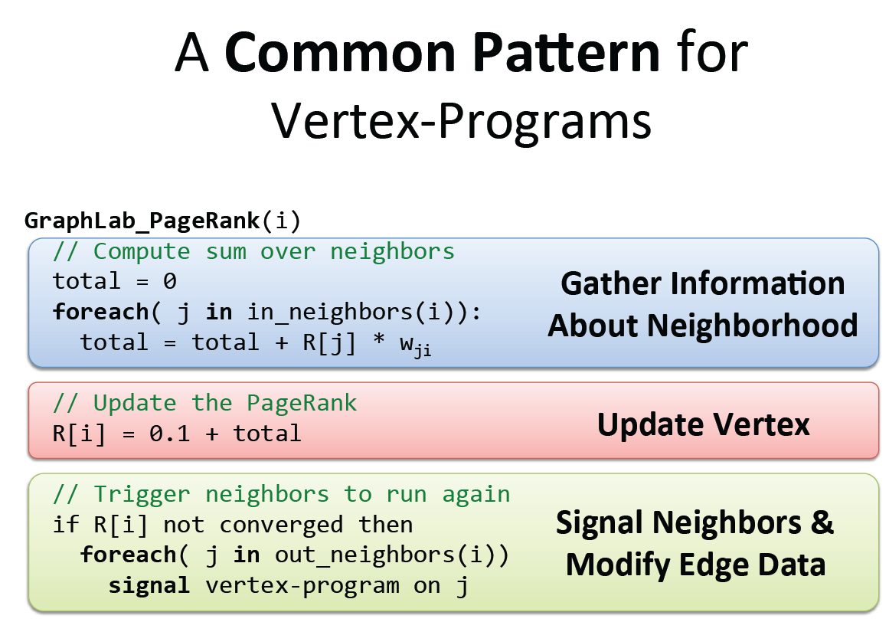

Slide 42
Generalized Graph Processing
for each vertex v
if v is active
for each edge e to v
Gather update along e
Apply updated value to v
B
38.4
C
34.3
A
3.3
if v has update
for each edge e from v
Scatter update along e
D
3.9
E
8.1
F
3.9
1.6
1.6
1.6
1.6
1.6

Slide 43
GAS
Gather (Reduce)
Apply
Scatter
Aggregate neighbors’ info
Update the vertex data
Update neighbor vertices and edges
User defined：
User defined：
User defined：
Gather( ) → Σ
Apply( , Σ) →
Scatter( ) →
Y
Y
Y’
Y’
Σ₁ + Σ₂ → Σ₃
Σ
Y’
Y
Y’
Y
Update edges and active vertices
Partial sum
+
+ … + →
Y
Y
Y

Slide 44
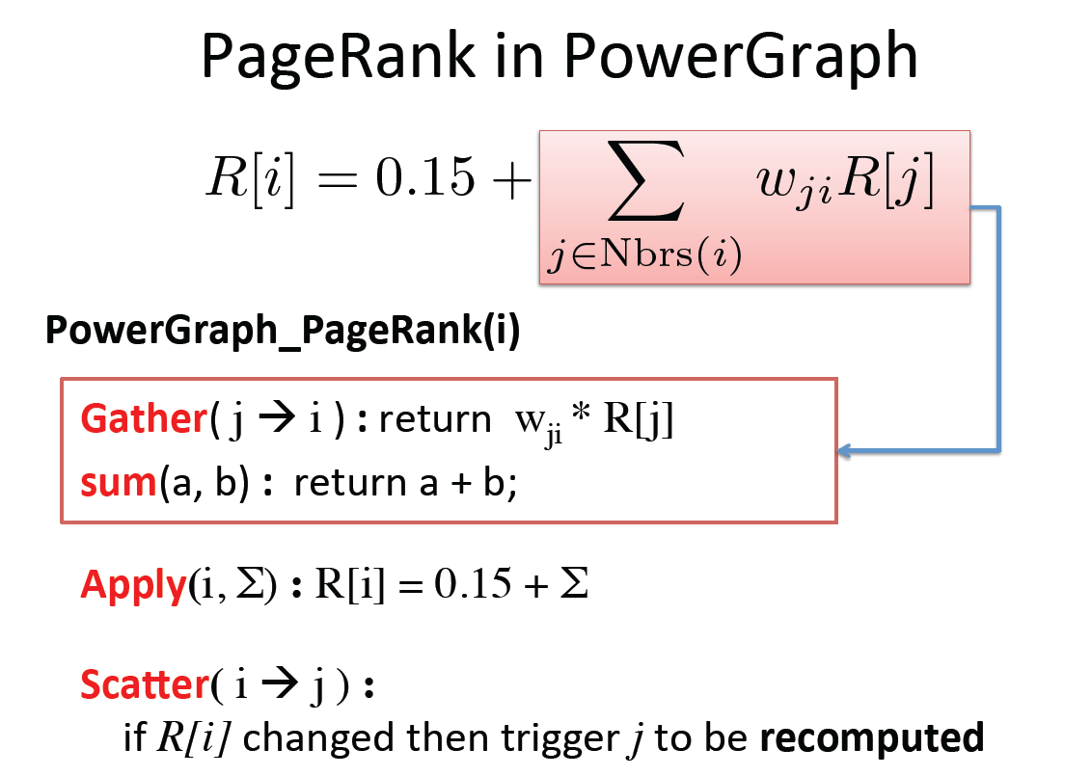

Slide 45
Distributed GAS
Machine 1
Machine 2
Master
Gather
Y’
Y’
Y’
Y’
Σ₁
Σ
Σ₂
+ + +
Mirror
Apply
Y
Y
Y
Y
Machine 3
Machine 4
Scatter
Σ₃
Σ₄
Mirror
Mirror

Slide 46
Constructing Vertex-Cuts
Goal: Parallel graph partitioning on ingress
GraphLab 2 provides three simple approaches:
Random Edge Placement
Edges are placed randomly by each machine
Good theoretical guarantees
Greedy Edge Placement with Coordination
Edges are placed using a shared objective
Better theoretical guarantees
Oblivious-Greedy Edge Placement
Edges are placed using a local objective
Notes:
Case 1: If A(u) and A(v) intersect, then the edge should be assigned to a machine in the intersection.
Case 2: If A(u) and A(v) are not empty and do not intersect, then the edge should be assigned to one of the machines from the vertex with the most unassigned edges.
Case 3: If only one of the two vertices has been assigned, then choose a machine from the assigned vertex.
Case 4: If neither vertex has been assigned, then assign the edge to the least loaded machine.

Slide 47
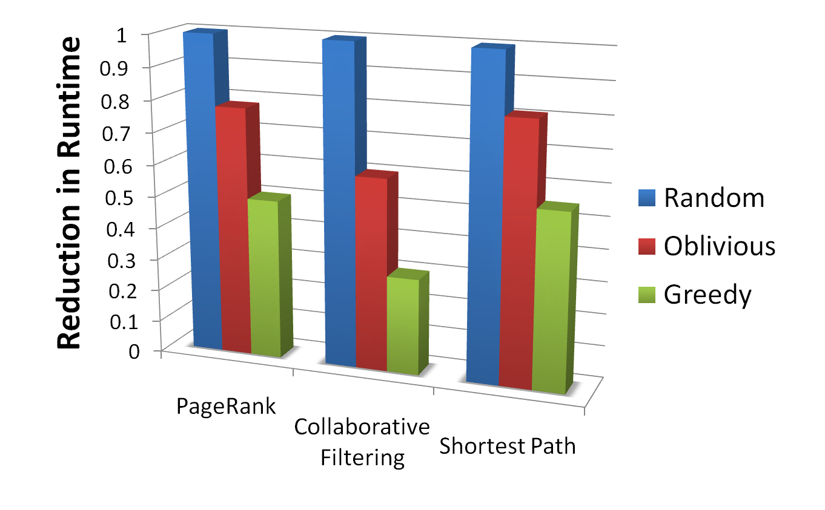
Beyond Random Vertex Cuts!

Slide 48
LDA Performance
All English language Wikipedia
2.6M documents, 8.3M words, 500M tokens
LDA state-of-the-art sampler (100 Machines)
Alex Smola: 150 Million tokens per Second
GraphLab Sampler (64 cc2.8xlarge EC2 Nodes)
100 Million Tokens per Second
Using only 200 Lines of code and 4 human hours

Slide 49
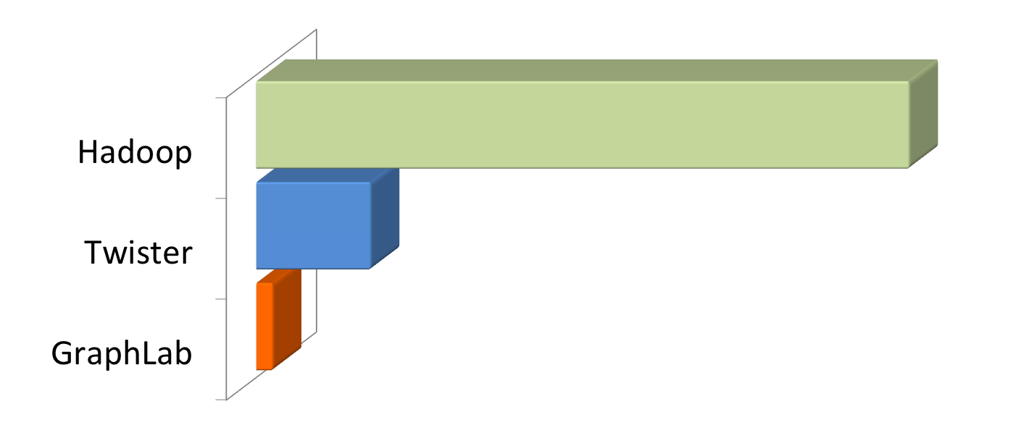
PageRank
5.5 hrs
$180
$41
1 hr
$12
8 min
40M Webpages, 1.4 Billion Links
Hadoop results from [Kang et al. '11]
Twister (in-memory MapReduce) [Ekanayake et al. ‘10]
Notes:
“Comparable numbers are hard to come by as everyone uses different datasets, but we try to equalize as much as possible giving the competition an advantage when in doubt”
Scaling to 100 iterations so costs are in dollars and not cents.
Numbers:
Hadoop: Ran on Kronecker graph of 1.1B edges, 50 M45 machines.
From available numbers, each machine is approximately 8 cores, 6 GB RAM or roughly a c1.xlarge instance. Putting total cost at $33 per hour
Spectral Analysis for Billion-Scale Graphs: Discoveries and Implementation U Kang Brendan Meeder Christos Faloutsos
Twister: Ran on ClueWeb dataset of 50M pages, 1.4B edges.
Using 64 Nodes of 4 cores each. 16GB RAM per node. Or roughly a m2.xlarge to m2.2xlarge instance. Putting total cost at $28-$56 per hour.
Jaliya Ekanayake, Hui Li, Bingjing Zhang, Thilina Gunarathne, Seung-Hee Bae, Judy Qiu, Geoffrey Fox, Twister: A Runtime for Iterative MapReduce," The First International Workshop on MapReduce and its Applications (MAPREDUCE'10) - HPDC2010
GraphLab: Ran on 64 cc1.4x large instances at $83.2 per hour

Slide 50

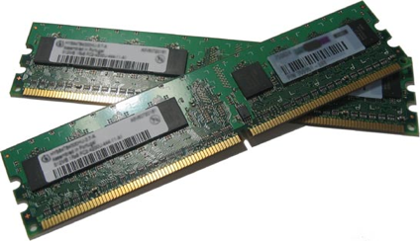

How well does GraphLab scale?
Yahoo Altavista Web Graph (2002):
One of the largest publicly available webgraphs
1.4B Webpages, 6.6 Billion Links
11 Mins
1B links processed per second
30 lines of user code
64 HPC Nodes
1024 Cores (2048 HT)
4.4 TB RAM

Slide 51
PowerLyra
PowerGraph partitions graph for high degree vertices, but is not friendly to the low degree vertices(locality)
Optimize the low degree vertices’ locality
Avoids unnecessary communications

Slide 52
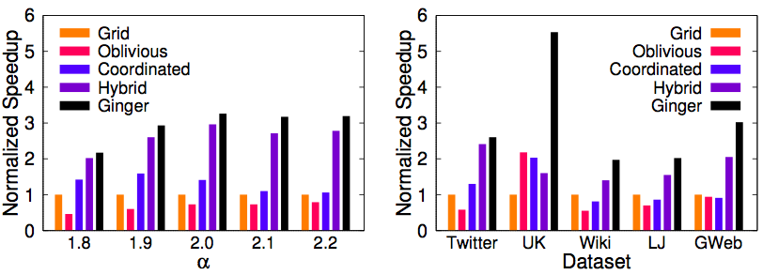
PowerLyra性能
Hybrid: 2.02X ~ 2.96X
Hybrid: 1.40X ~ 2.05X
Ginger: 2.17X ~ 3.26X
Ginger: 1.97X ~ 5.53X
better
Power-law Graphs
Real-world Graphs
PageRank Gather: IN / Scatter: OUT
48 machines and baseline: PowerGraph + Grid (default)
Notes:
5 systems, the first 3 is powergraph and the next 2 is powerlyra
We use default setting as baseline

Slide 53
Outline
Applications of Graph Analysis
Vertex-centric graph processing
Asynchronous processing
Graph partition on power law graphs and GAS model
Out of core graph processing

Slide 54
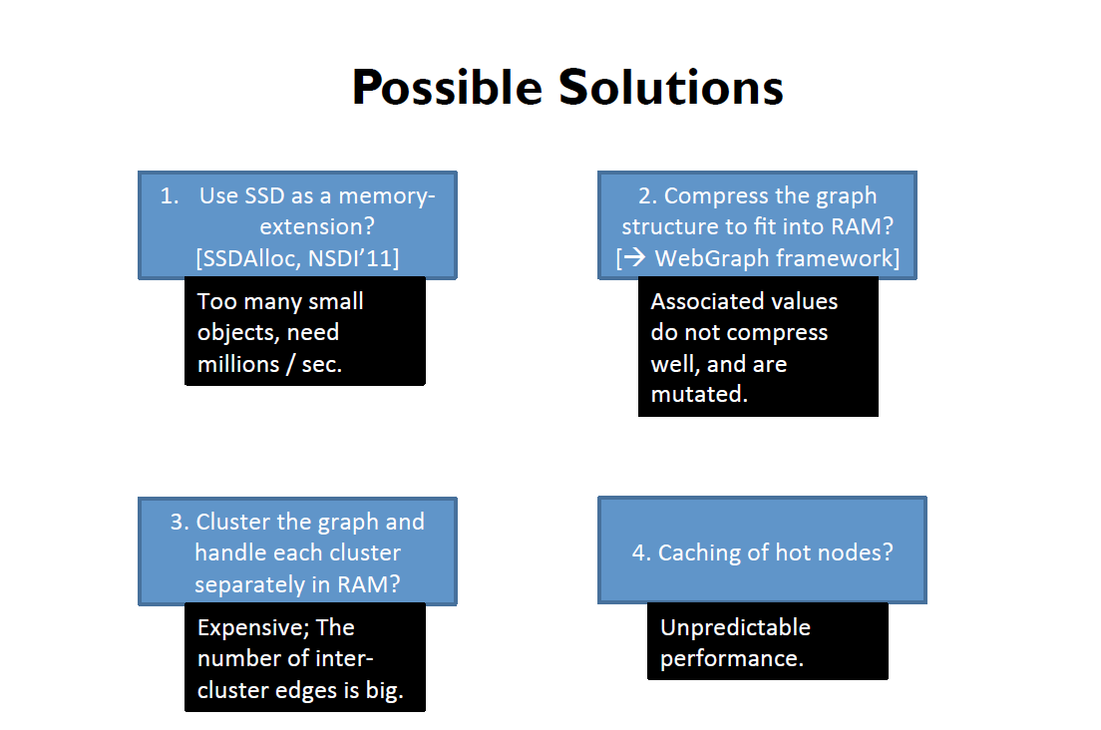
Out-of-core Graph Processing
Processing large graphs with limited memory
Low cost graph analysis engine

Slide 55
Single machine out-of-core graph processing
Reorder computing and memory accessing
GraphChi
Kyrola, A., Blelloch, G., & Guestrin, C. (2012). Graphchi: Large-scale graph computation on just a {PC}. In Presented as part of the 10th {USENIX} Symposium on Operating Systems Design and Implementation ({OSDI} 12) (pp. 31-46).
Xstream
Roy, A., Mihailovic, I., & Zwaenepoel, W. (2013, November). X-stream: Edge-centric graph processing using streaming partitions. In Proceedings of the Twenty-Fourth ACM Symposium on Operating Systems Principles (pp. 472-488).
GridGraph
Zhu, X., Han, W., & Chen, W. (2015). GridGraph: Large-scale graph processing on a single machine using 2-level hierarchical partitioning. In 2015 {USENIX} Annual Technical Conference ({USENIX}{ATC} 15) (pp. 375-386).

Slide 57
Generalized Graph Processing
for each vertex v
if v is active
for each edge e to v
gather update along e
apply updated value to v
Vertex
1 2 3 4
if v has update
for each edge e from v
scatter update along e
Edge
1 → 2 1 → 3
2 → 1 2 → 4
3 → 2
4 → 2 4 → 3
A lot of random accesses to vertices, vertices should in memory
Notes:
Edges out of memory, and we , wish to access them sequentially
Put all in edges of v together

Slide 58
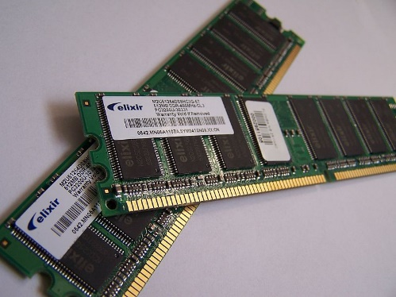
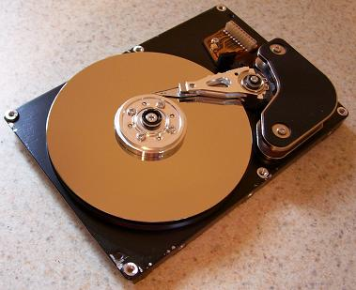
Performance gap between disks and memory
 | Memory | Disk
Sequential Access (200X) | 20GB/s | 100MB/s
Random Access (100,000X) | 100ns | 10ms
SSD is in between, but still favor sequential accesses
Notes:
这个原则适应各个内存层次

Slide 59
The key of out-of-core graph systems is the
sequential access to graph data

Slide 60
Generalized Graph Processing
for each vertex v
if v is active
for each edge e to v
gather update along e
apply updated value to v
Vertex
1.0 1.0 1.0 1.0
if v has update
for each edge e from v
scatter update along e
Edge
1 → 2 1 → 3
2 → 1 2 → 4
3 → 2
4 → 2 4 → 3
How to store edges? Can accesses to edges sequential?
Notes:
Edges out of memory, and we , wish to access them sequentially
Put all in edges of v together

Slide 61
Generalized Graph Processing
for each vertex v
if v is active
for each edge e to v
gather update along e
apply updated value to v
Vertex
1.0 1.0 1.0 1.0
if v has update
for each edge e from v
scatter update along e
Edge
2 → 1
1 → 2 3 → 2 4 → 2
1 → 3 4 → 3
2 → 4
Sort edges by destination vertex id
Now gather is accessing edges sequentially
Notes:
Edges out of memory, and we , wish to access them sequentially
Put all in edges of v together

Slide 62
Generalized Graph Processing
for each vertex v
if v is active
for each edge e to v
gather update along e
apply updated value to v
Vertex
1.0 1.0 1.0 1.0
if v has update
for each edge e from v
scatter update along e
Edge
1 → 2 1 → 3
2 → 1 2 → 4
3 → 2
4 → 2 4 → 3
Sort edges by src vertex id
Now scatter is accessing edges sequentially
Notes:
Edges out of memory, and we , wish to access them sequentially
Put all in edges of v together

Slide 63
Generalized Graph Processing
for each vertex v
if v is active
for each edge e to v
gather update along e
apply updated value to v
Vertex
1.0 1.0 1.0 1.0
if v has update
for each edge e from v
scatter update along e
Edge
1 → 2 1 → 3
2 → 1 2 → 4
3 → 2
4 → 2 4 → 3
2 → 1
1 → 2 3 → 2 4 → 2
1 → 3 4 → 3
2 → 4
Scatter and Gather do not share a common edge list
The accesses to two edge lists are interleaved
Notes:
Edges out of memory, and we , wish to access them sequentially
Put all in edges of v together

Slide 64
Generalized Graph Processing
for each vertex v
if v is active
for each edge e to v
gather update along e
apply updated value to v
Vertex
1.0 1.0 1.0 1.0
Edge
1 → 2 1 → 3
2 → 1 2 → 4
3 → 2
4 → 2 4 → 3
2 → 1
1 → 2 3 → 2 4 → 2
1 → 3 4 → 3
2 → 4
for each vertex v
if v has update
for each edge e from v
scatter update along e
Gather&Apply can be separated from Scatter

Slide 65
Generalized Graph Processing
for each vertex v
if v is active
for each edge e to v
gather update along e
apply updated value to v
Vertex
1.0 1.0 1.0 1.0
Edge
1 → 2 1 → 3
2 → 1 2 → 4
3 → 2
4 → 2 4 → 3
2 → 1
1 → 2 3 → 2 4 → 2
1 → 3 4 → 3
2 → 4
for each vertex v
if v has update
for each edge e from v
scatter update along e
Can we use just one copy of the edge list?
Do we need all vertices in memory?

Slide 66
Thanks

